Slide 1

The Performance Analysis of Supervised Machine Learning in Cooperative NOMA
Sai Teja & Narveer
ELL725 – Wireless Communication
Prof. Manav Bhatnagar
Department of Electrical Engineering – IIT Delhi

Slide 2
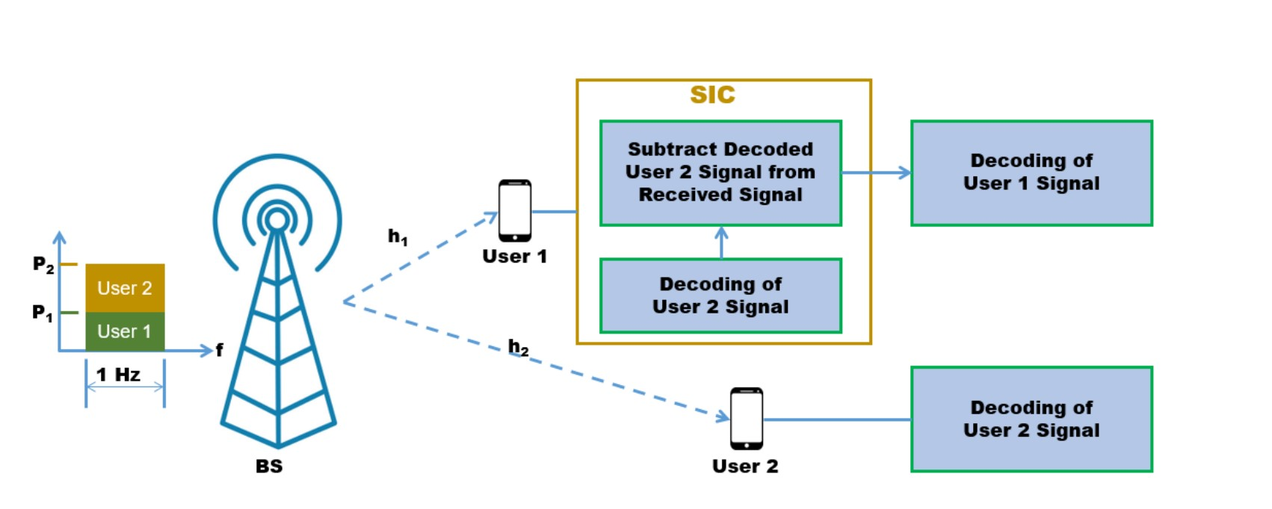
NOMA :
It allows multiple users to share the same frequency resources by using different power levels and/or codebooks to separate their signals at the receiver.
Advantages - Spectral Efficiency, Better User Fairness, Lower Latency
More number of users can be served.
NOMA is being actively researched and developed for future wireless communication systems

Slide 3
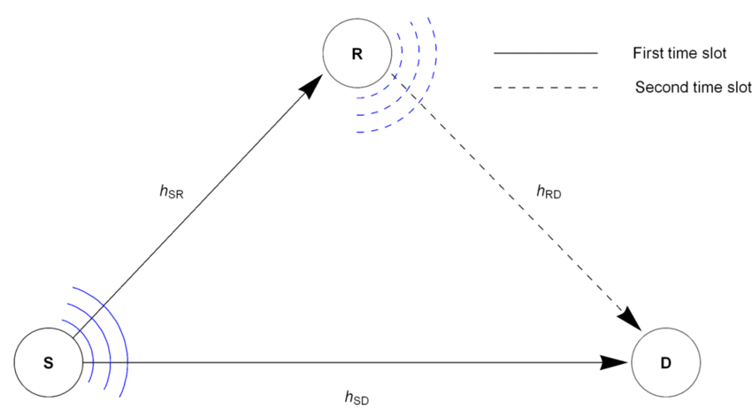
Cooperative Communication :
Multiple users collaborate to transmit their signals to the receiver.
Relay, where one or more users act as relays to transmit signals from the base station to another user.
Relay can be a dedicated device or a user device.
Improved coverage area, increased reliability, and higher data rates

Slide 4
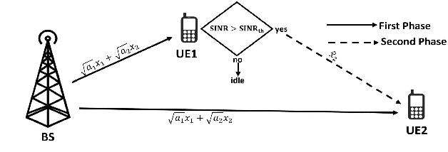
Cooperative Noma:
Multiple users collaborate to transmit their signals to the receiver using superposition coding and cooperative relaying.

Slide 5
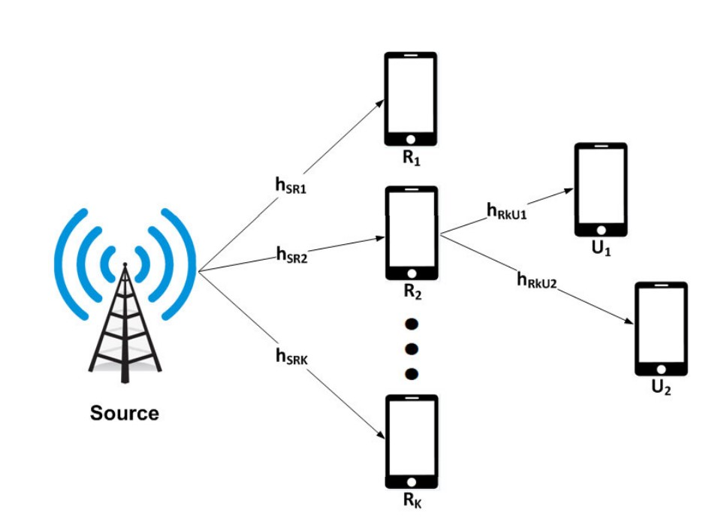
System Model
Assumption:
Communication to user is via relay only
All channels are independent.

Slide 6
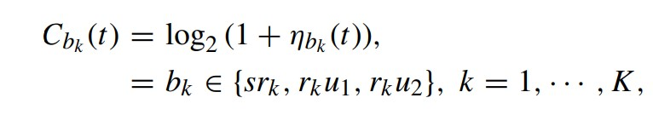



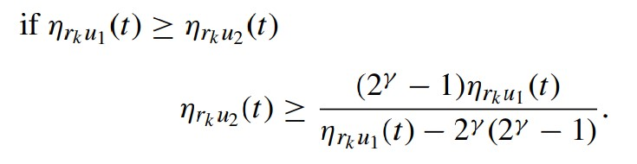
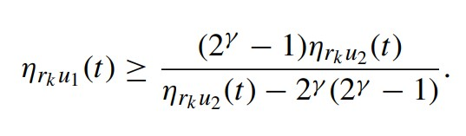

Conditions For NOMA transmission
Conditions For OMA transmission
Far User
Near User
$η_{rku1}\left(t\right) ≤ η_{rk2}\left(t\right)$

Slide 7
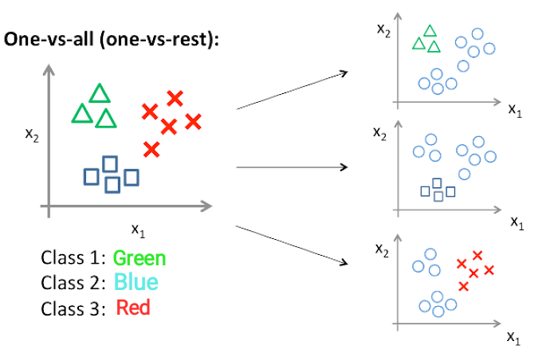

SVM :
SVMs are a type of supervised learning algorithm used in machine learning for classification and regression analysis.
The basic idea behind SVMs is to find the hyperplane that maximally separates the data points of different classes in the feature space.
For k class SVMs we model k different binary SVM

Slide 8
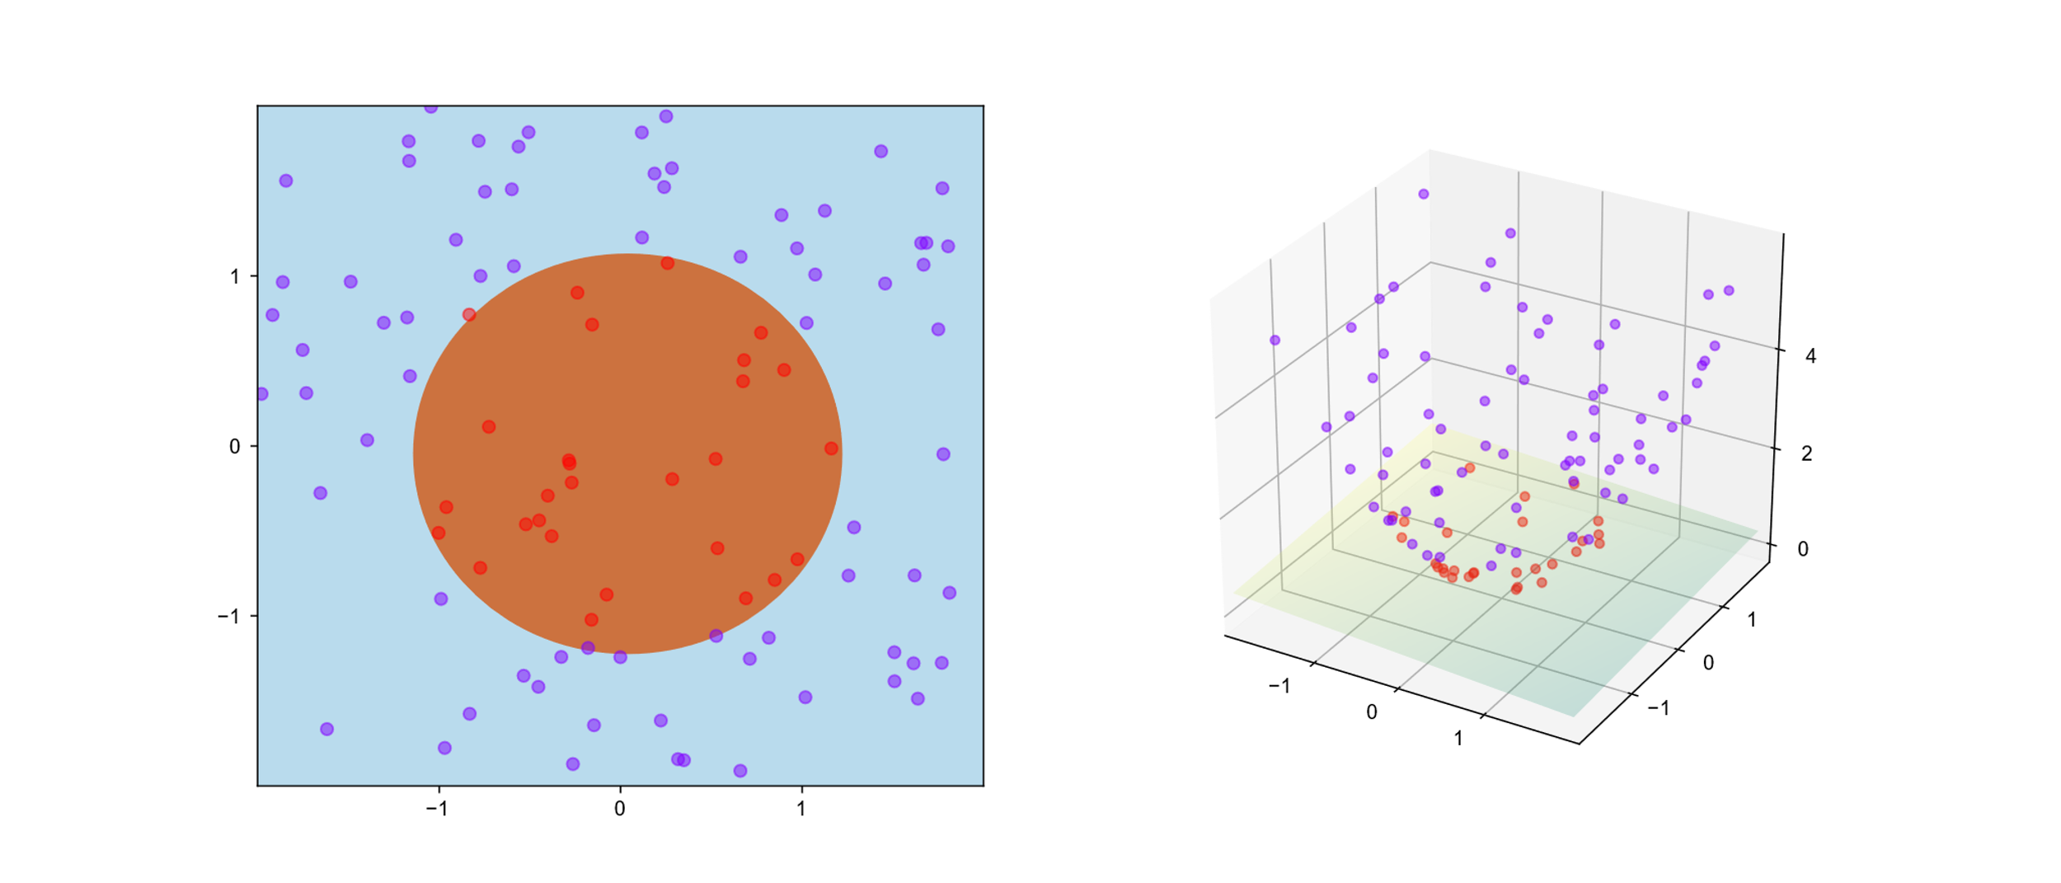
For data classifier, we Kernel
Kernel :
Measures the similarity between two data points in a high-dimensional space.
It maps the input data into a high-dimensional feature space
Various types of kernels: linear kernels, polynomial kernels, and radial basis function (RBF) kernels.
Gaussian : K(x, x') = exp(-gamma * ||x - x'||^2)

Slide 9
Simulation
Dataset generation
Training
Testing
Throughput comparison
All the stages have been implemented by us on Matlab

Slide 10
Throughput Comparison

Slide 11
References:
[1] M. Alkhawatrah, "The Performance of Supervised Machine Learning Based Relay Selection in Cooperative NOMA," in IEEE Access, vol. 11, pp. 1570-1577, 2023, doi: 10.1109/ACCESS.2022.3233443.
[2] Z. Ding, H. Dai and H. V. Poor, "Relay Selection for Cooperative NOMA," in IEEE Wireless Communications Letters, vol. 5, no. 4, pp. 416-419, Aug. 2016, doi: 10.1109/LWC.2016.2574709.

Slide 12
Thanks For Your Kind Attention

